Slide 1
Remaining Work & Next Steps
Manuscript work (paper)
Implementation work (code)
Update methodology to include partial recharging.
Update test instance generator description and validation checks.
Rewrite computational results section with new experiments + tables/figures.
Revise the entire manuscript.
Already implemented: full recharge, partial recharge, and greedy scheduler.
Tested with initial
Update the test generator??.
Run all algorithms on new test instances and regenerate performance summaries.
Automate infeasibility logging (which constraint fails first; where/when).
Testing blockers & immediate actions
Observed infeasibility causes
Plan?
Generator bug fixed: distance mistakenly included return-to-origin in the “total distance” field (last leg ≈ 3000 km).
Remaining infeasibility mostly tied to rest-time constraints in some instances which charging-station density/placement is ~40 km.
Run a smaller grid: parameters combination and number of tests

Slide 2
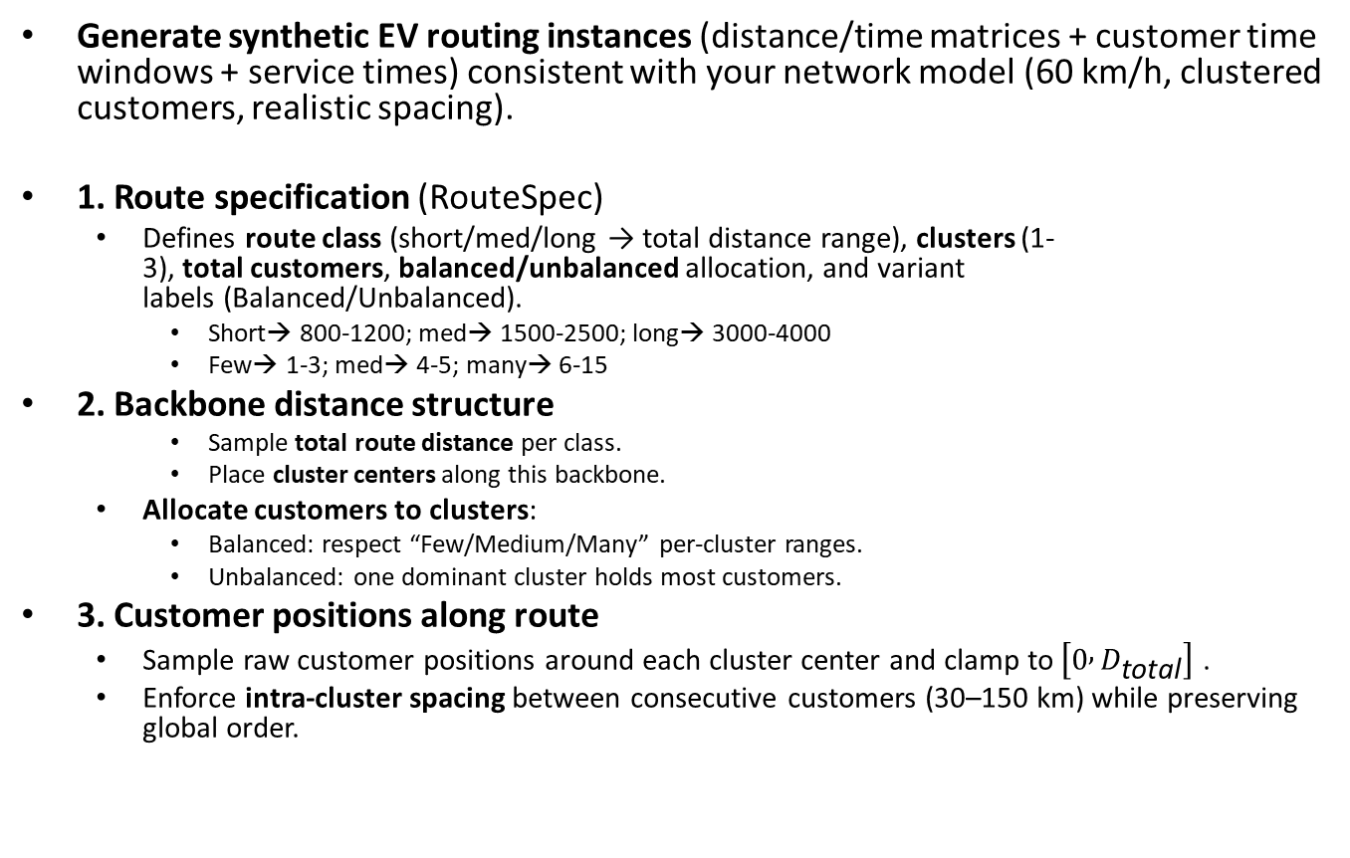
Instance Generator: High‑level logic
Generate synthetic EV routing instances (distance/time matrices + customer time windows + service times) consistent with your network model (60 km/h, clustered customers, realistic spacing).
1. Route specification (RouteSpec)
  Defines route class (short/med/long → total distance range), clusters (1-3), total customers, balanced/unbalanced allocation, and variant labels (Balanced/Unbalanced).
    Short→ 800-1200; med→ 1500-2500; long→ 3000-4000
    Few→ 1-3; med→ 4-5; many→ 6-15
2. Backbone distance structure
    Sample total route distance per class.
    Place cluster centers along this backbone.
  Allocate customers to clusters:
    Balanced: respect “Few/Medium/Many” per‑cluster ranges.
    Unbalanced: one dominant cluster holds most customers.
3. Customer positions along route
  Sample raw customer positions around each cluster center and clamp to $\left[0 , D_{\text{total}}\right]$ .
  Enforce intra‑cluster spacing between consecutive customers (30–150 km) while preserving global order.

Slide 3
Improvement Case Analysis (Partial vs Full Recharging)
Figures and Interpretation

Slide 4
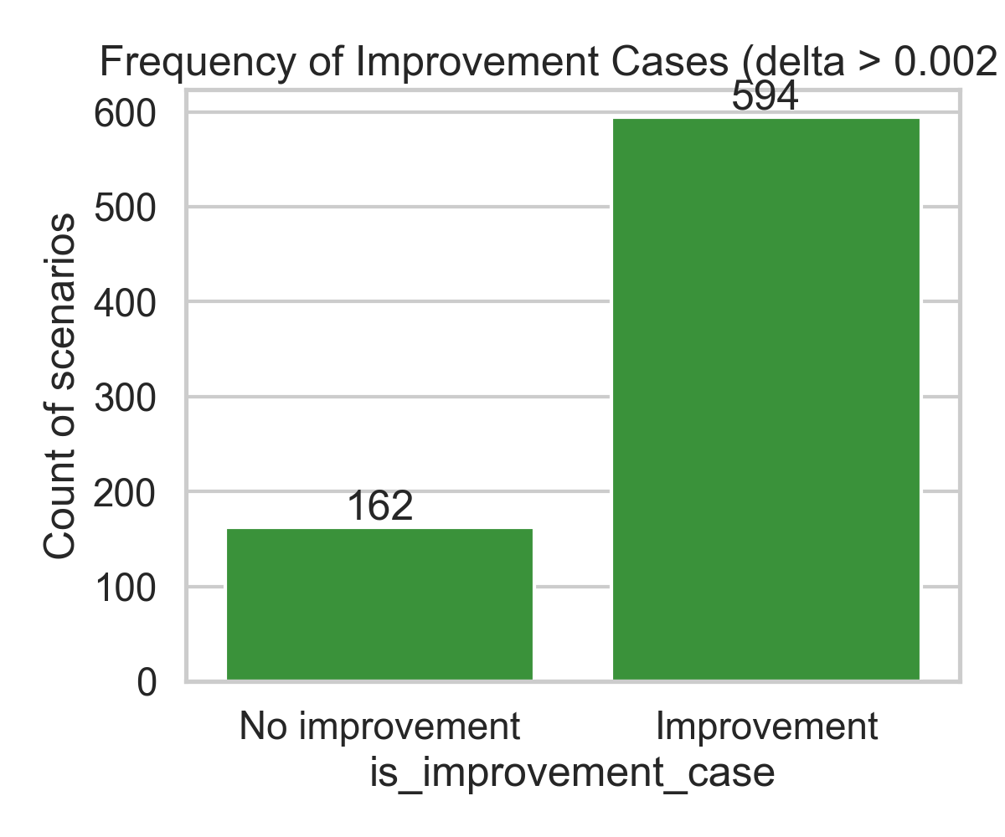
Improvement Cases Overall
In total, ~594 scenarios show improvement; ~162 show none.
Confirms partial charging is generally beneficial.]
Non-improvement cases occur mostly in unconstrained situations (big battery, fast charging).

Slide 5
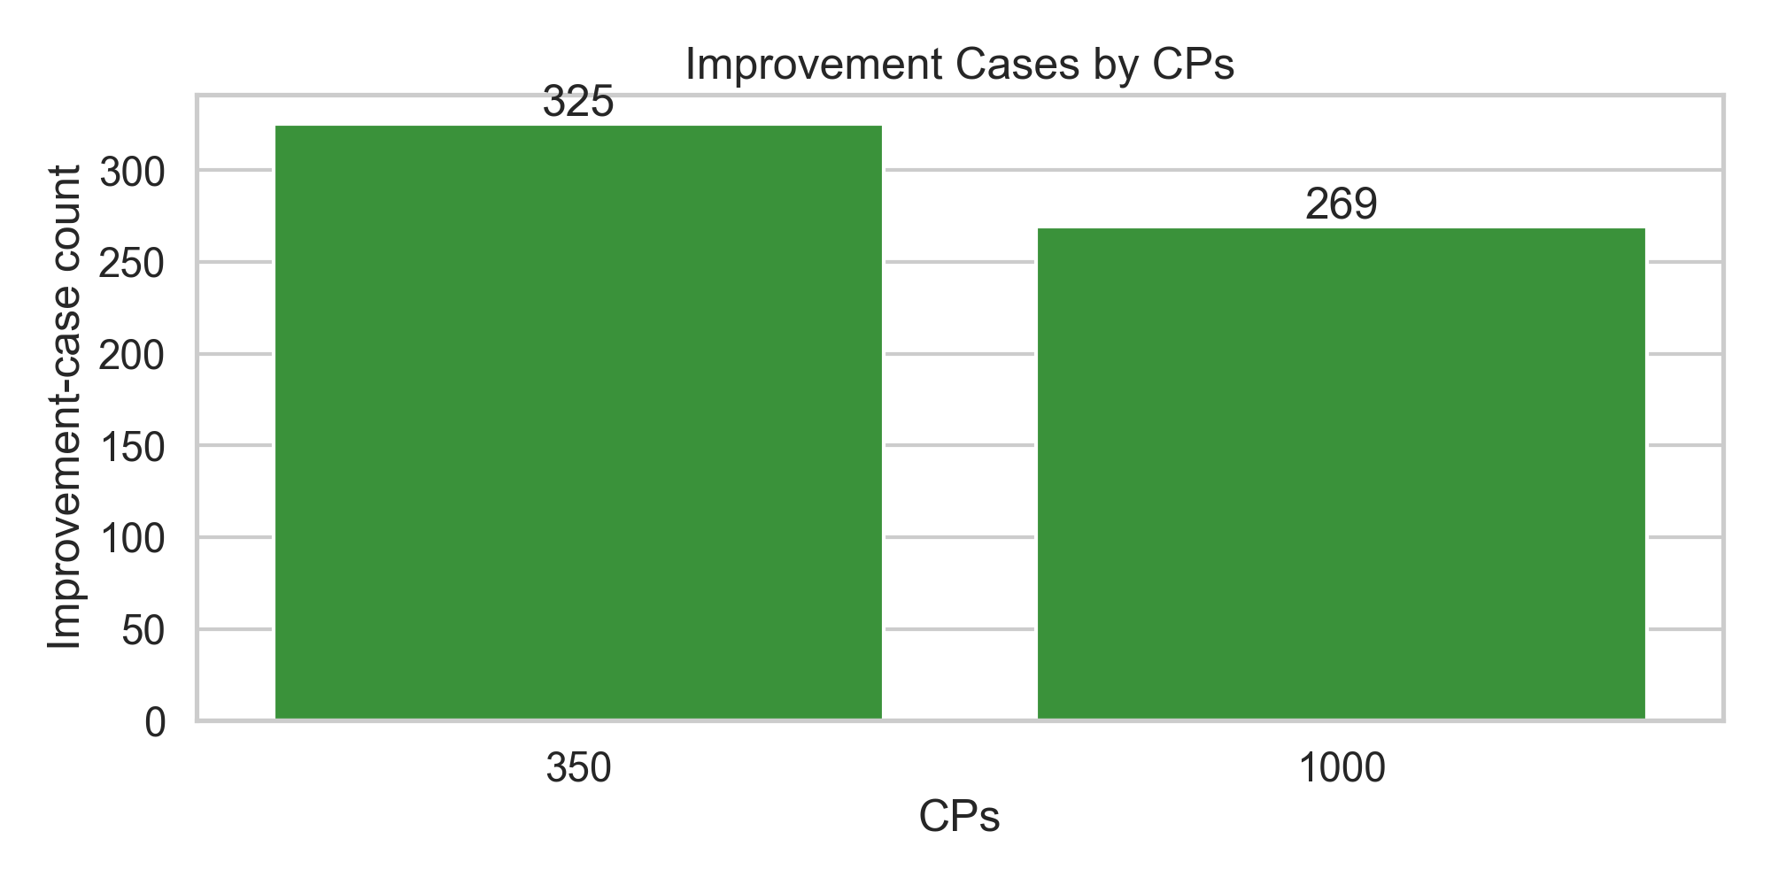
Improvement Cases by CPs
More improvements with 350 kW charging (325 cases) than with 1000 kW (269 cases).
Slow charging makes scheduling strategies critical; partial charging reduces wasted charging time.
With 1000 kW, charging is fast enough that partial vs full makes less difference.

Slide 6
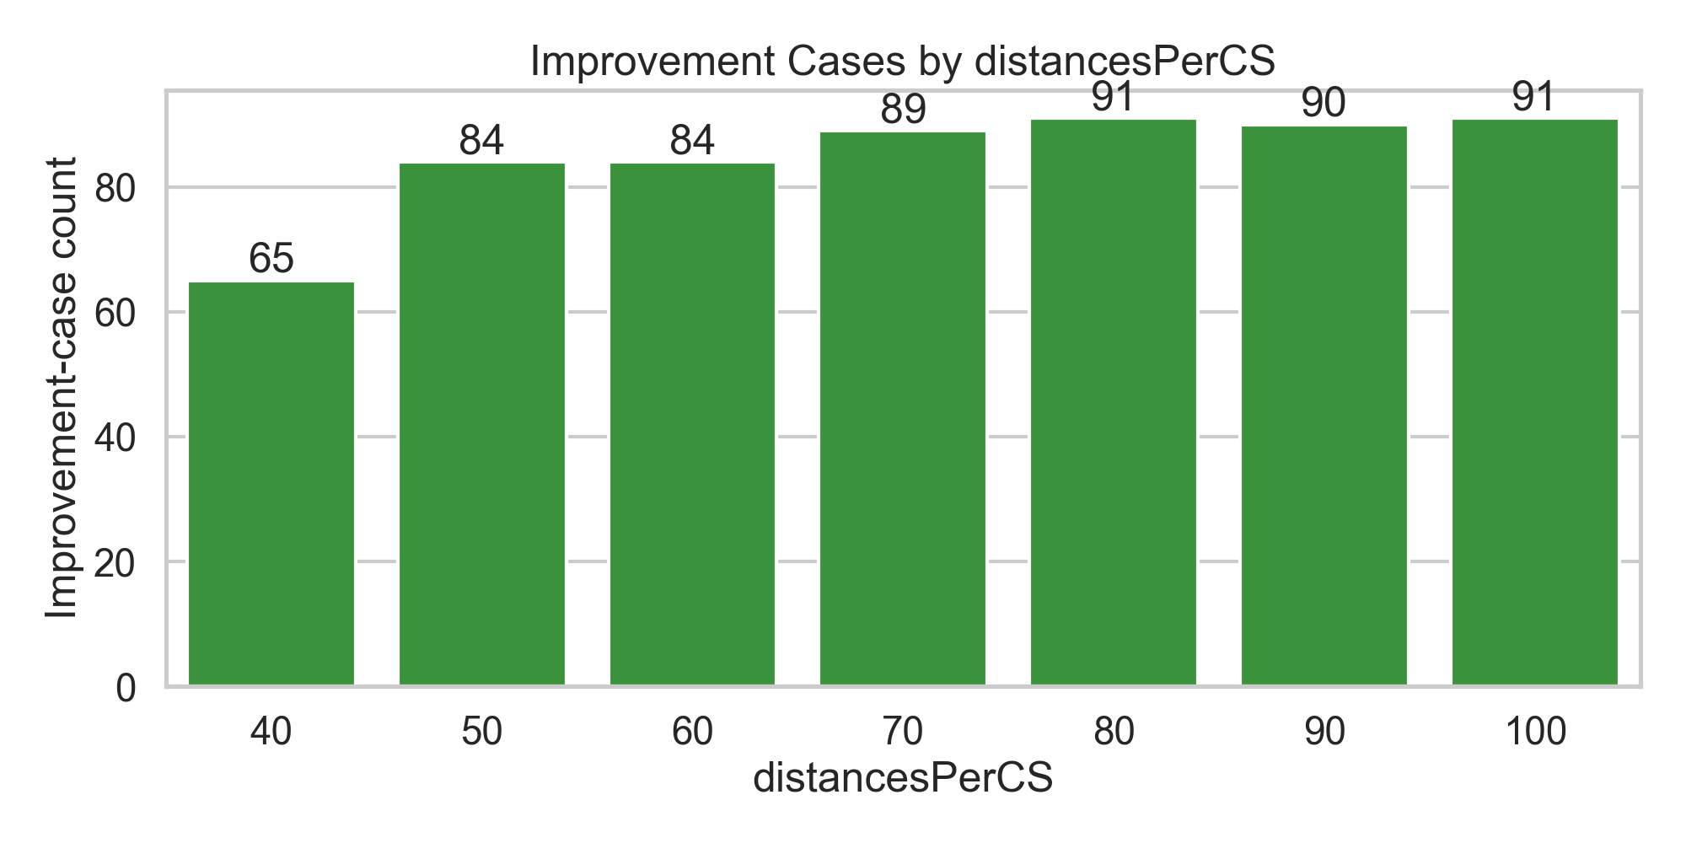
Improvement Cases by distancesPerCS
Fewer improvements with very dense CS (40 km, 65 cases). Improvements rise as spacing increases (up to ~90 cases).
With sparse networks, flexibility from partial charging becomes crucial.
Dense networks allow frequent stops, reducing the advantage.

Slide 7
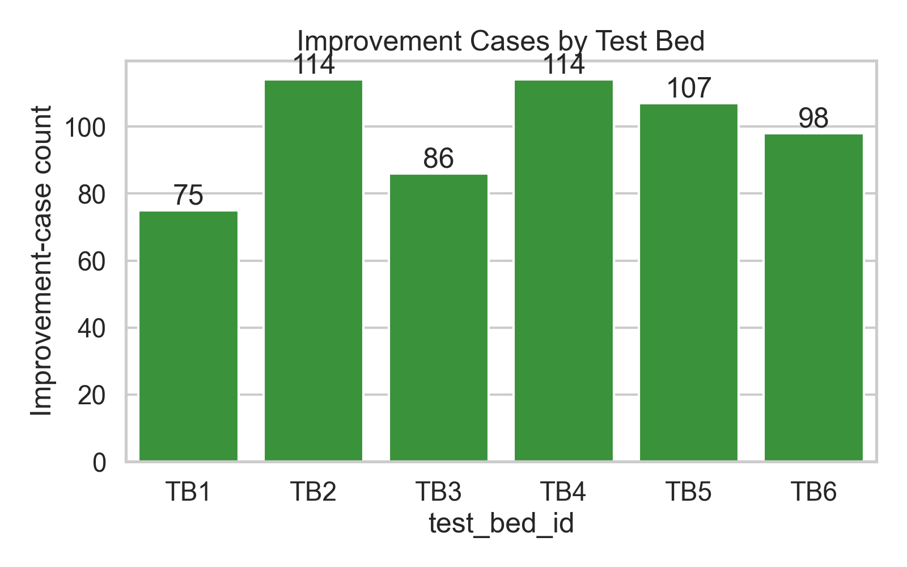
Improvement Cases by Testbed
Testbeds TB2 and TB4 have most improvement cases (~114 each), TB1 the least (~75).
Route design affects importance of partial charging. Tight time windows or long legs magnify benefits.
Variation shows scenario dependence.

Slide 8
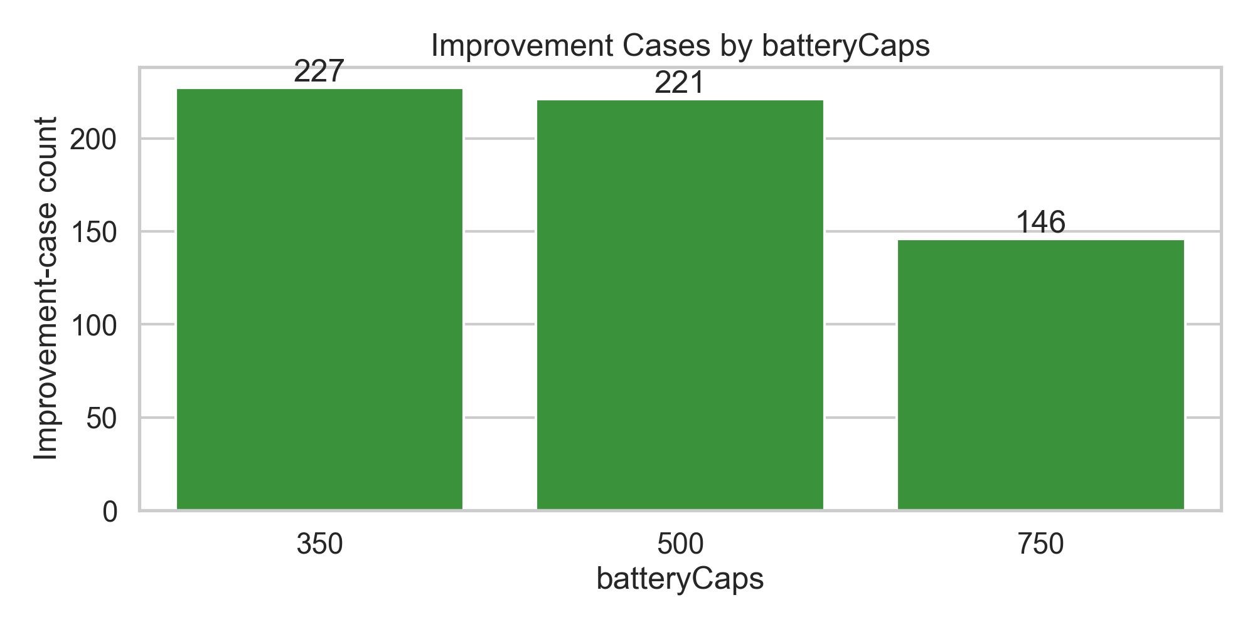
Improvement Cases by Battery Capacity
Smaller batteries (350, 500 kWh) show more improvements (227, 221 cases). Larger batteries (750 kWh) show fewer (146).
With small batteries, trucks need frequent recharging, making partial strategies effective. Large batteries reduce dependency.

Slide 9
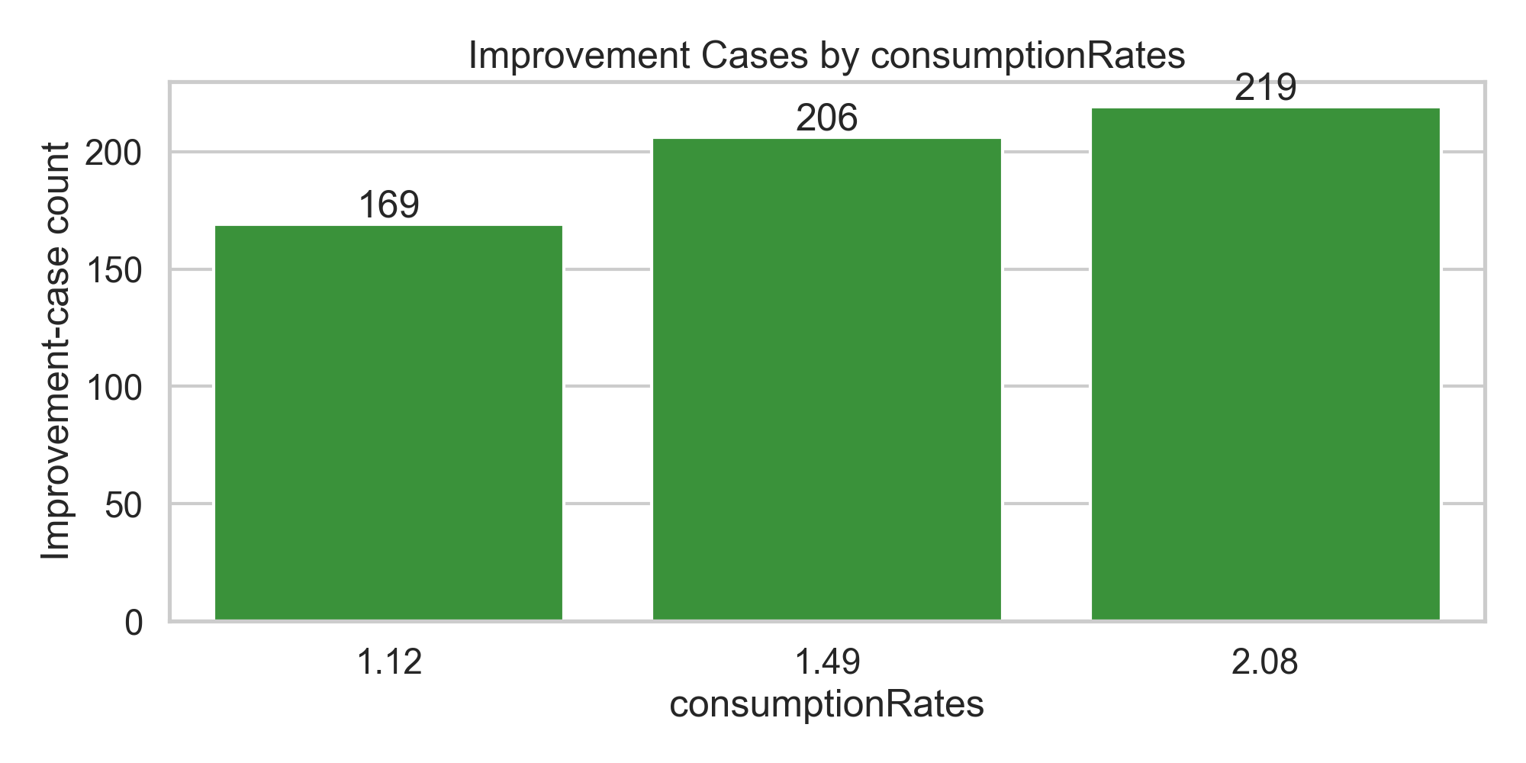
Improvement Cases by Consumption Rates
Improvements increase with worse consumption (169 → 219 cases).
Higher consumption = shorter range = more charging required. Partial charging reduces inefficiency.

Slide 10
Key Takeaways from Improvement Analysis
Charging Power: Partial charging benefits are strongest at low CP (350 kW).
Charging Station Density: Sparse networks increase benefits of partial charging.
Battery Capacity: Smaller batteries gain more from partial strategies.
Consumption Rates: Less efficient trucks gain more improvement.
Testbed Variability: Route structure strongly affects whether partial charging helps.
Overall: Partial charging improves schedules in ~80% of scenarios.

Slide 11
Sensitivity Analysis of EVTDSP Results with First Set of Test Instances

Slide 12
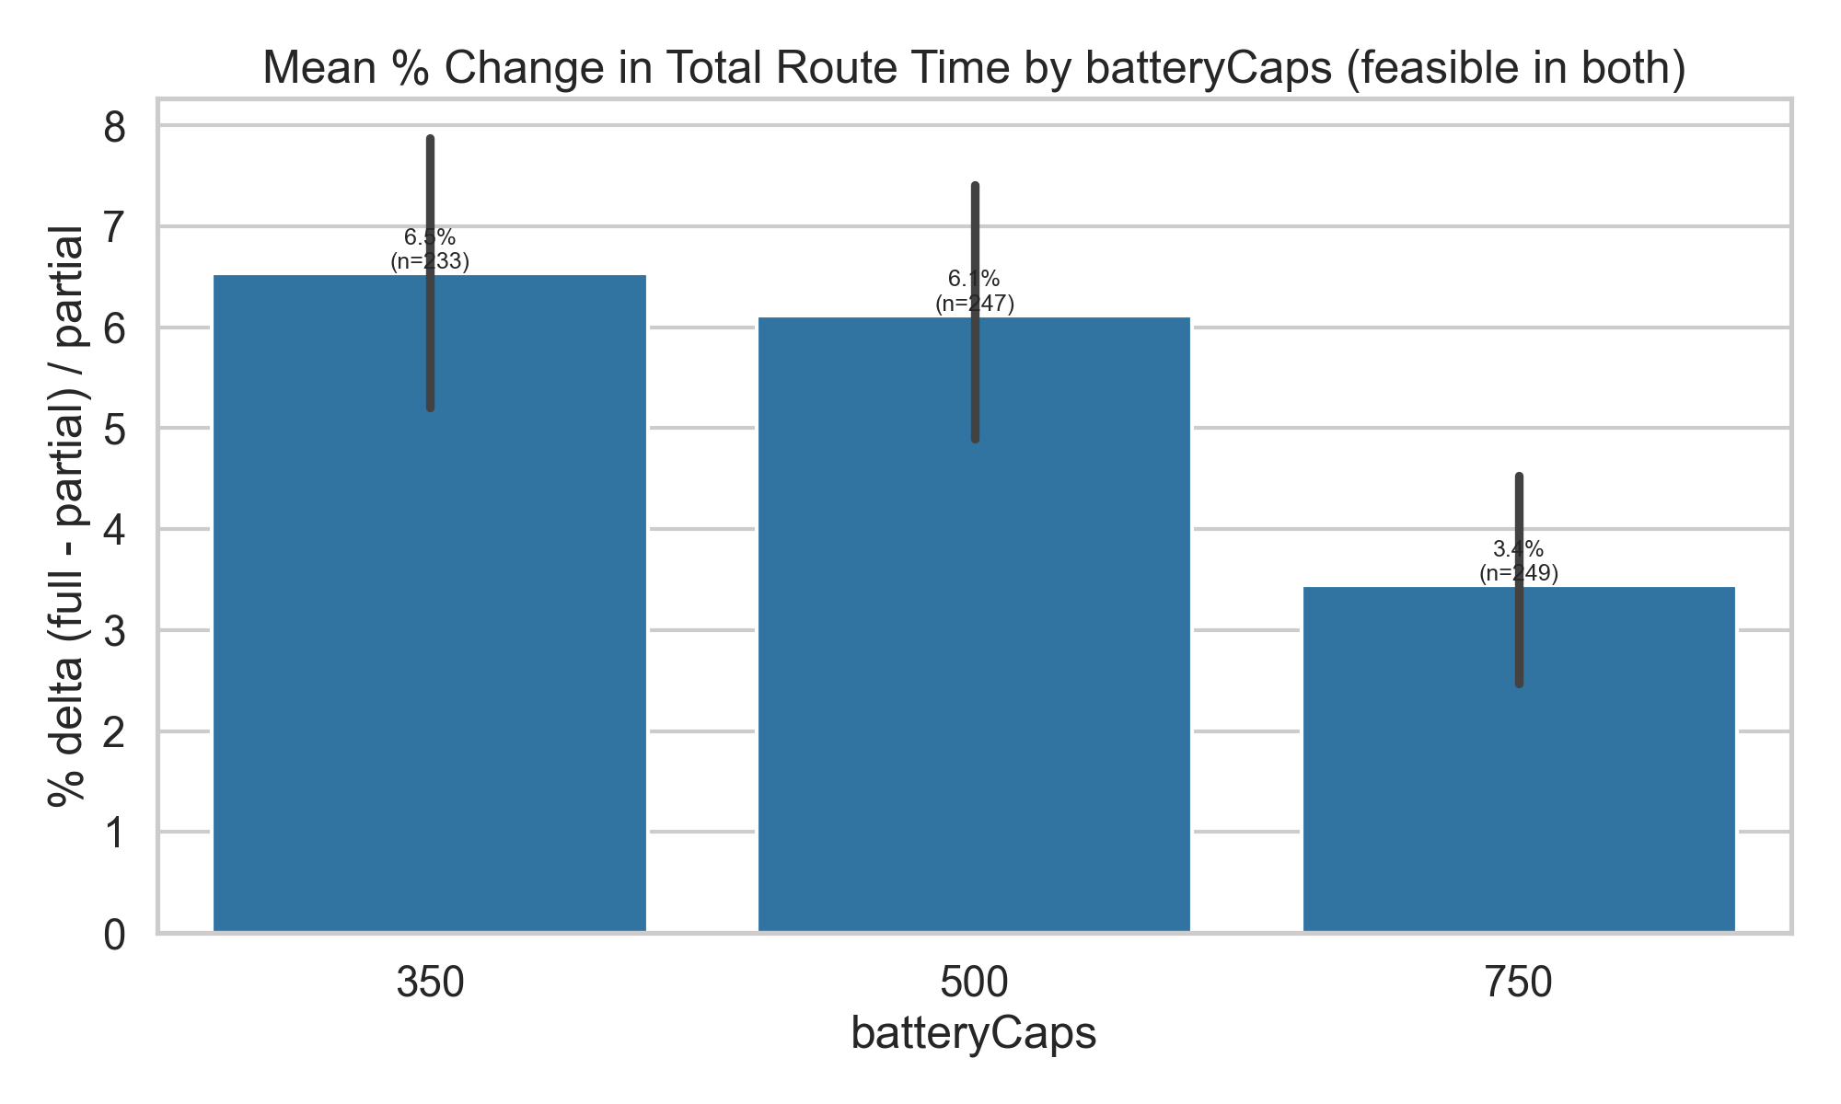
Battery Capacity (Delta)
Observation: Smaller batteries (350 kWh) show higher delta (~6%), while larger batteries (750 kWh) show much lower (~3%).
Reasoning: With small batteries, trucks need more charging stops, making synchronization of breaks and charging more impactful. Larger batteries extend range, so fewer stops are needed, reducing differences.

Slide 13
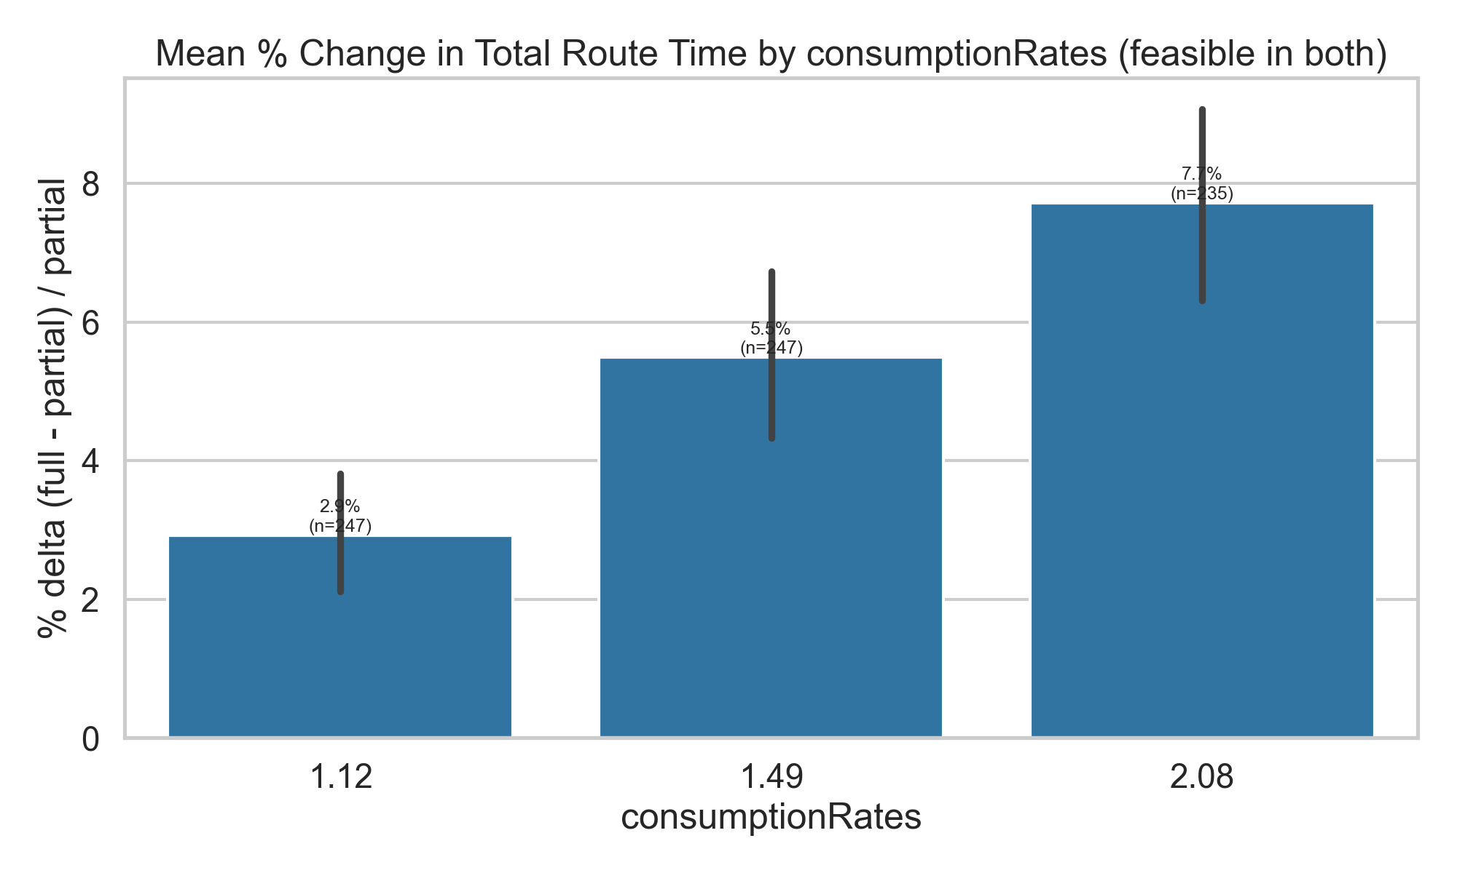
Consumption Rates (Delta)
Observation: Delta increases as consumption worsens (1.12 → 2.08 kWh/km).
Reasoning: Inefficient trucks deplete their batteries quickly, requiring more charging and making synchronization more critical. Efficient trucks rarely run into charging constraints, so deltas are smaller.

Slide 14
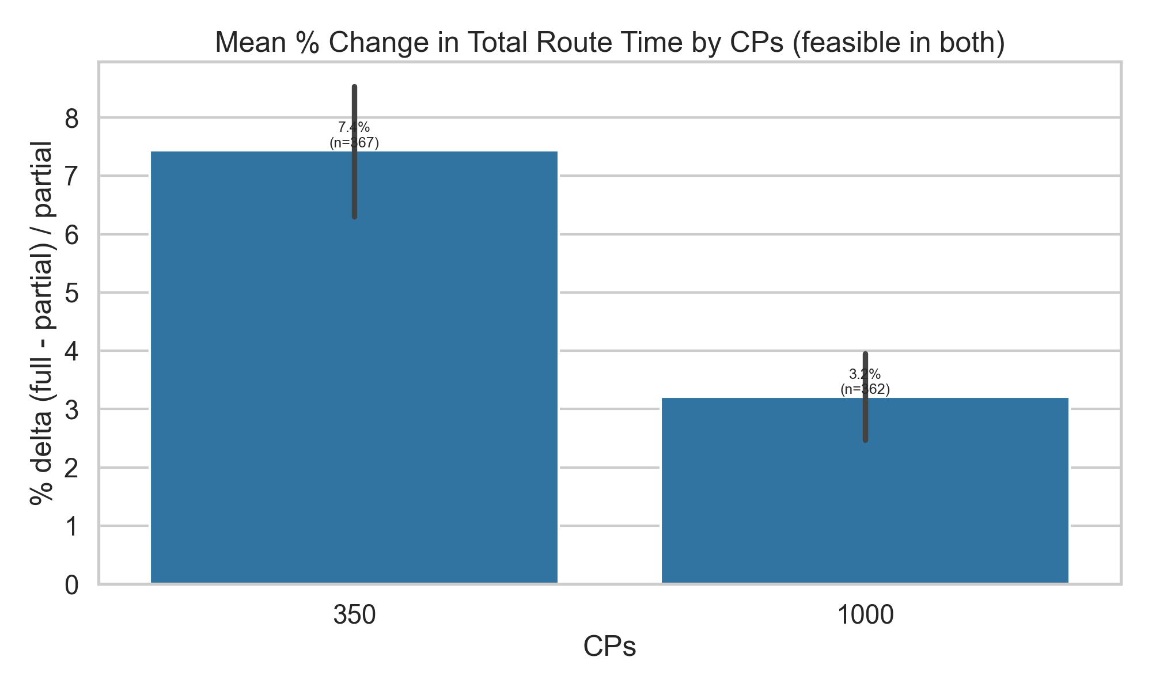
Charging Power (Delta)
Observation: At 350 kW, deltas are high (~7%). At 1000 kW, they drop to ~3%.
Reasoning: Slow charging magnifies the time savings of partial charging, while fast charging minimizes the difference between strategies.

Slide 15
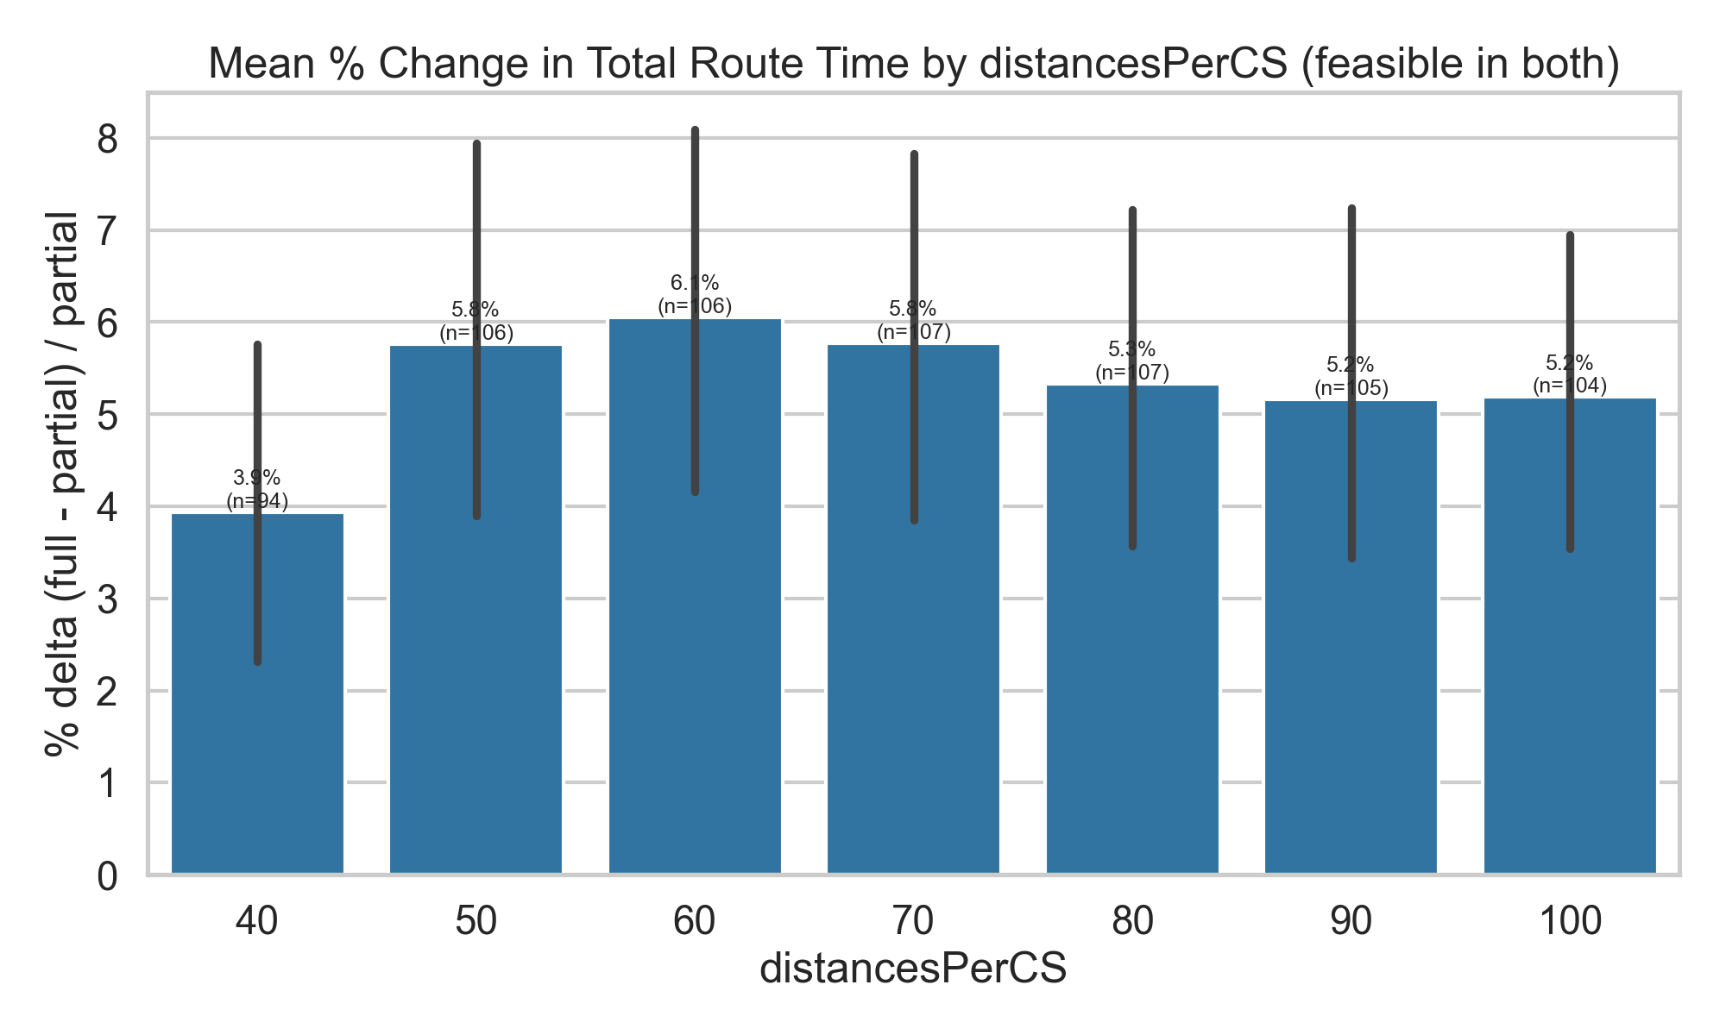
Distances per CS (Delta)
Observation: Deltas are lower with dense CS networks (40 km) and higher when stations are sparser (60–100 km).
Reasoning: Sparse infrastructure limits options, so synchronization and partial charging matter more. With frequent stations, flexibility is higher and strategies converge.

Slide 16
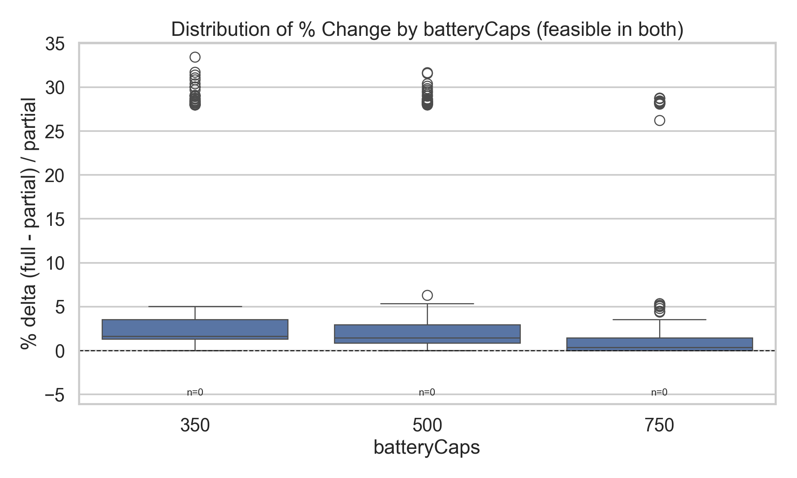
Battery Capacity (Box Plot)
Observation: Spread and outliers are much larger for small batteries, shrinking with capacity.
Reasoning: With limited energy, charging needs are unpredictable, creating variability. Large batteries stabilize the schedule.

Slide 17
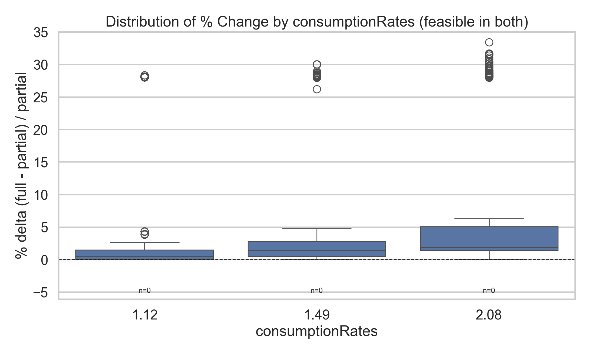
Consumption Rates (Box Plot)
Observation: Both median and spread grow as consumption worsens.
Reasoning: High consumption forces more charging and increases sensitivity to when and where charging is done.

Slide 18
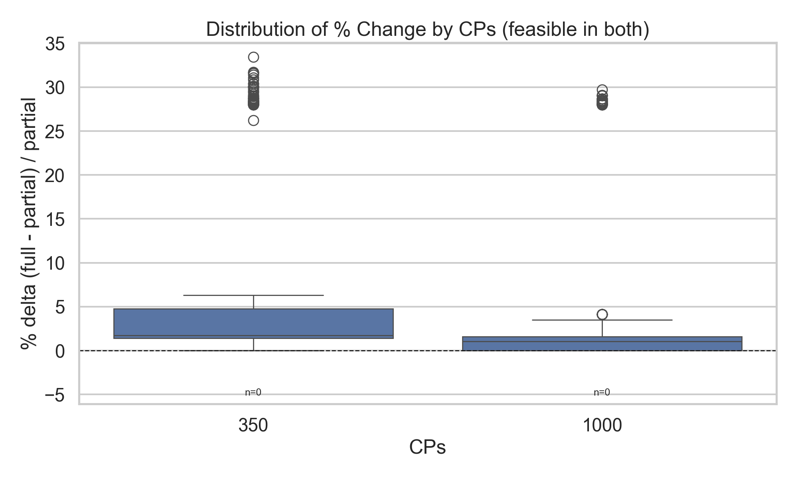
Charging Power (Box Plot)
More variability at low CP; distributions are tighter at 1000 kW.
Fast charging reduces the importance of planning, slow charging magnifies differences.

Slide 19
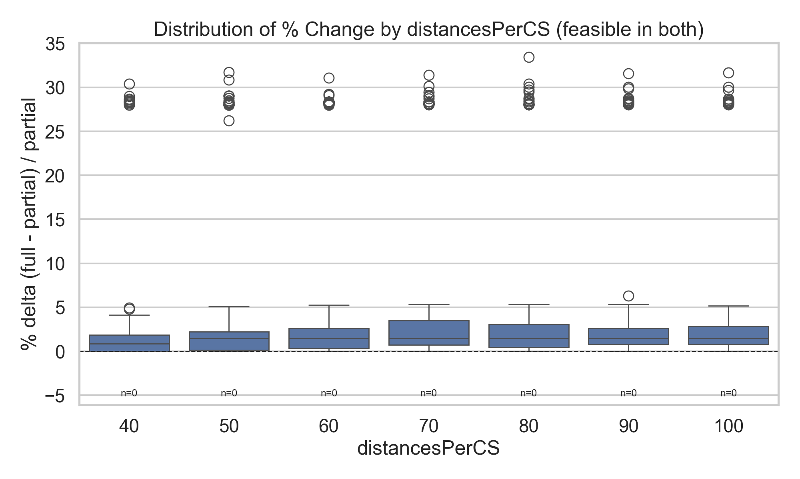
Distances per CS (Box Plot)
Median deltas grow slightly with longer CS spacing, and variability increases.
Sparse networks amplify constraints and make synchronization valuable.

Slide 20
Equal Case Analysis (Partial vs Full Recharging)
Figures and Interpretation

Slide 21
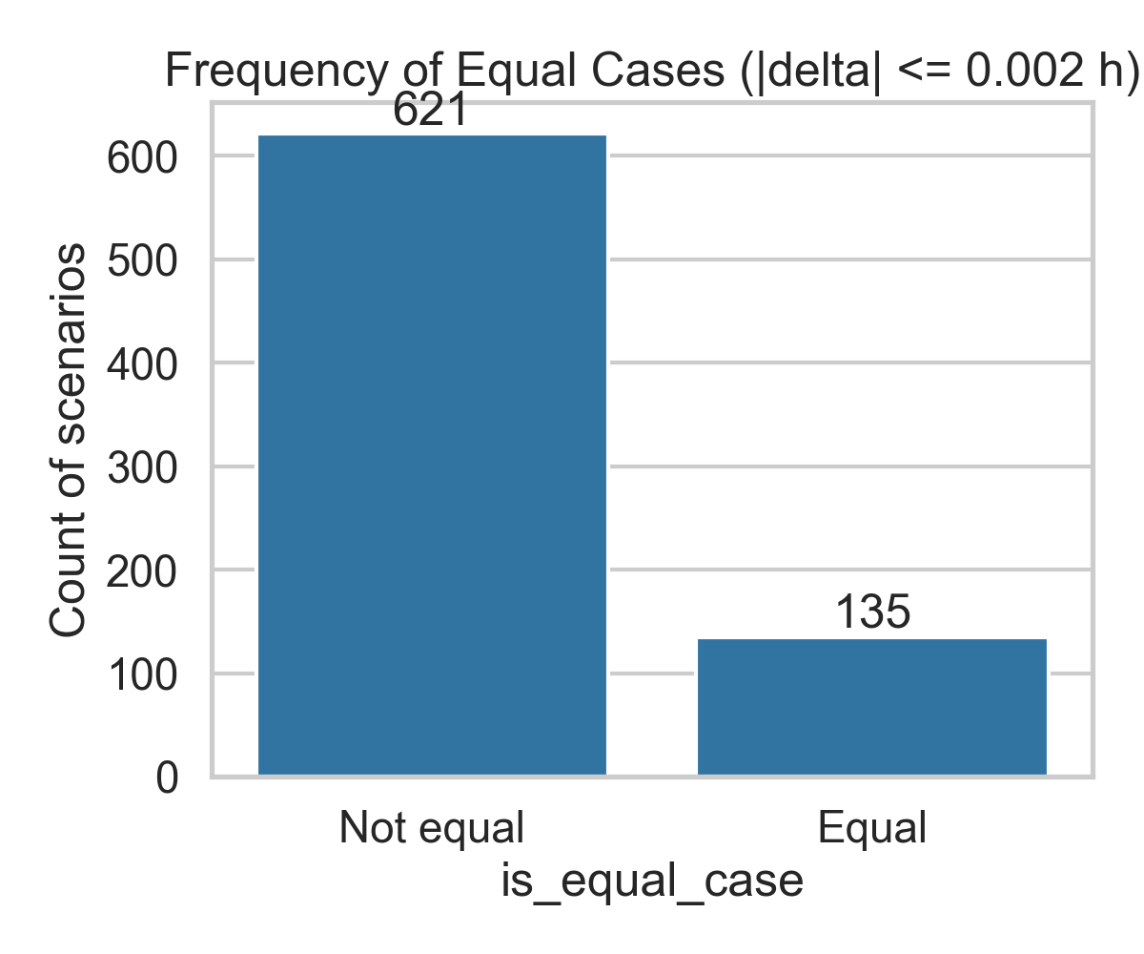
Equal Cases Overall
Majority (~621) are non-equal, but ~135 are equal.
Confirms that partial recharging is usually beneficial, but not universally. Equal cases exist when constraints are mild.

Slide 22
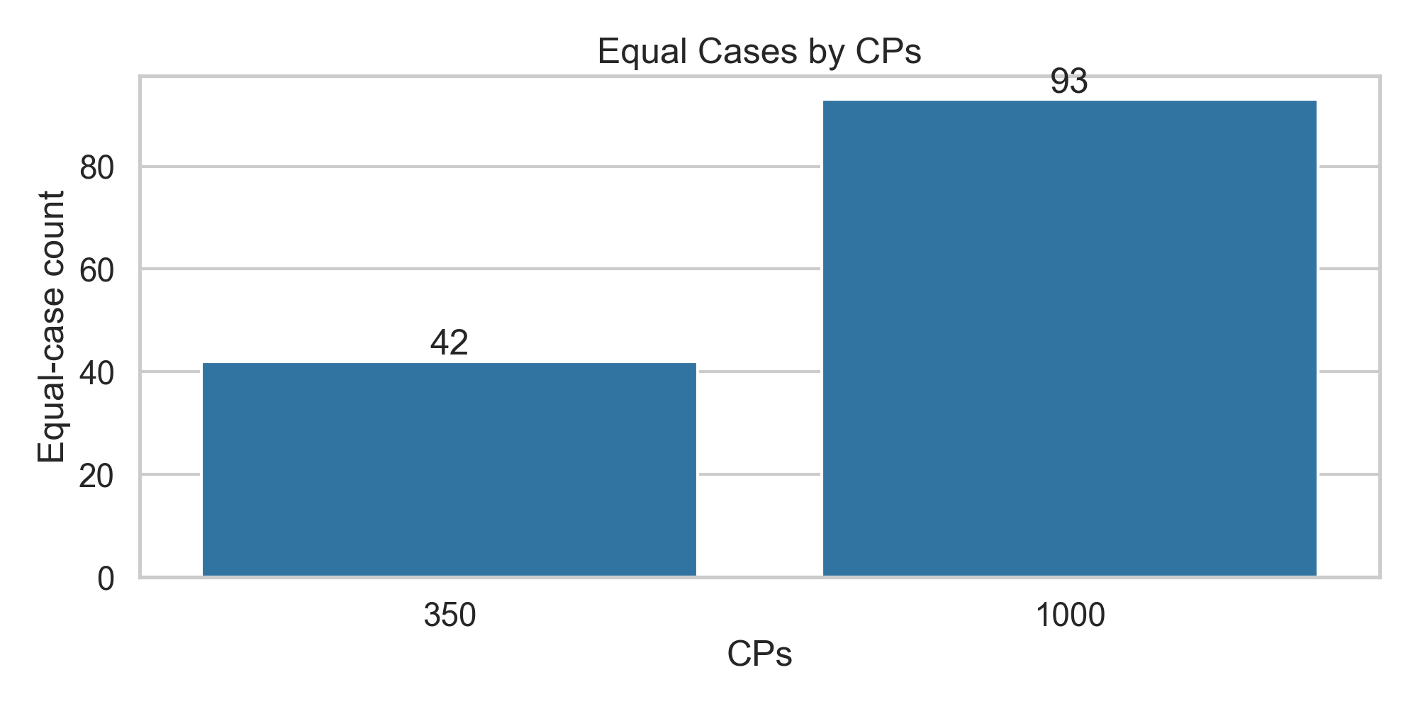
Equal Cases by CPs
Many equal cases at 1000 kW, fewer at 350 kW.
With very fast charging, charging time is negligible, so full vs partial recharging doesn’t change results. At low CP, strategies matter more.

Slide 23
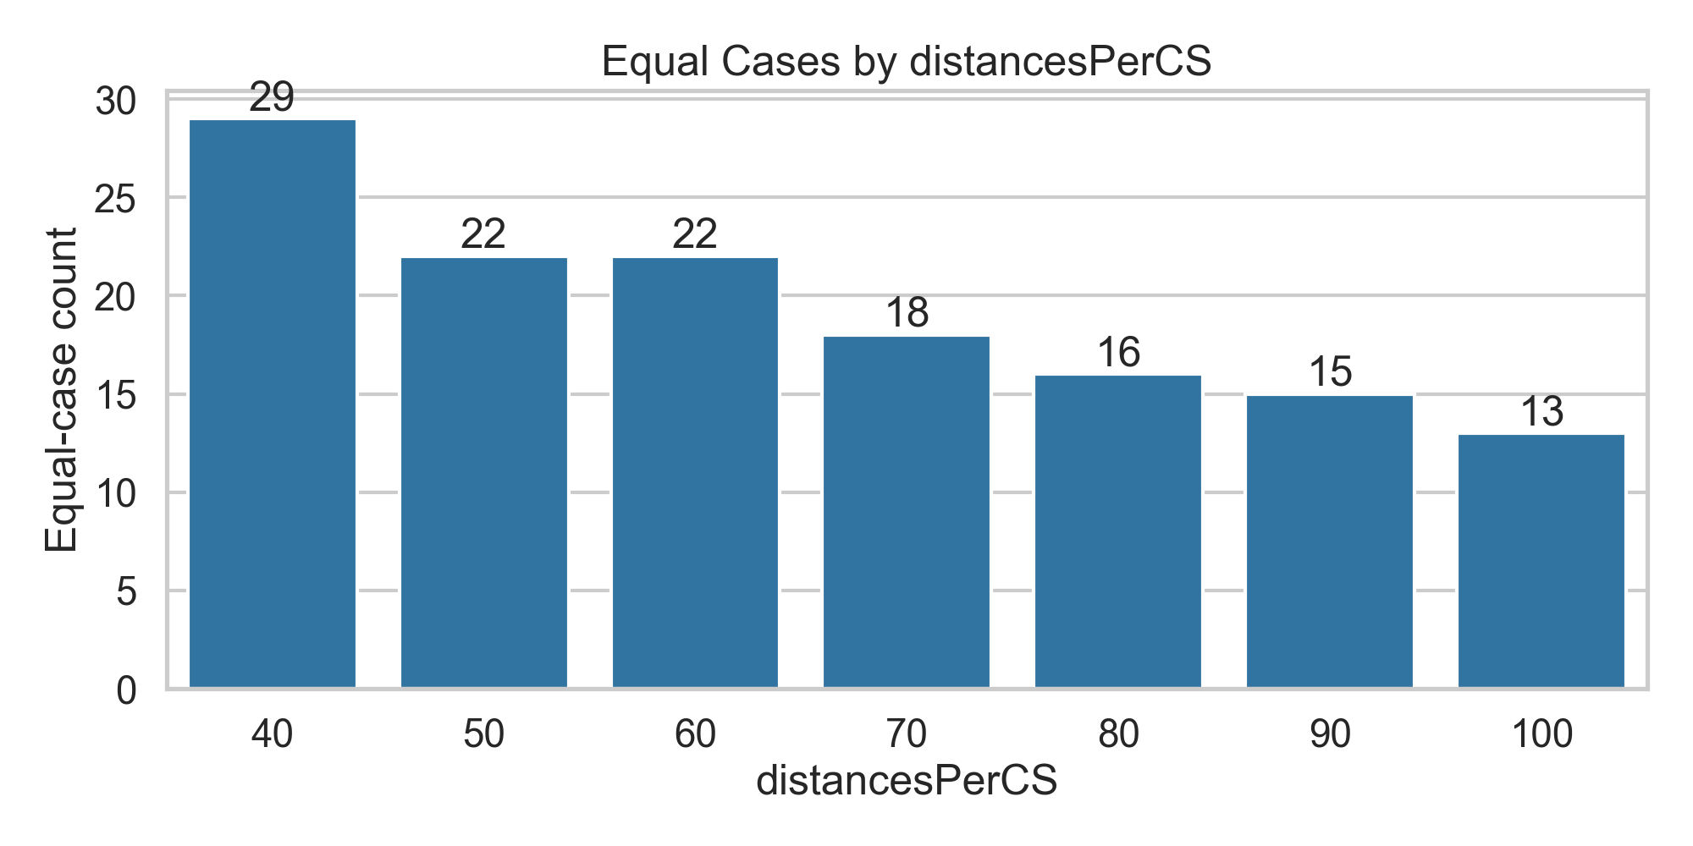
Equal Cases by distancesPerCS
More equal cases when CSs are close (40 km), fewer when far (100 km).
Dense infrastructure gives flexibility, so strategies converge. Sparse networks make partial charging more impactful.

Slide 24
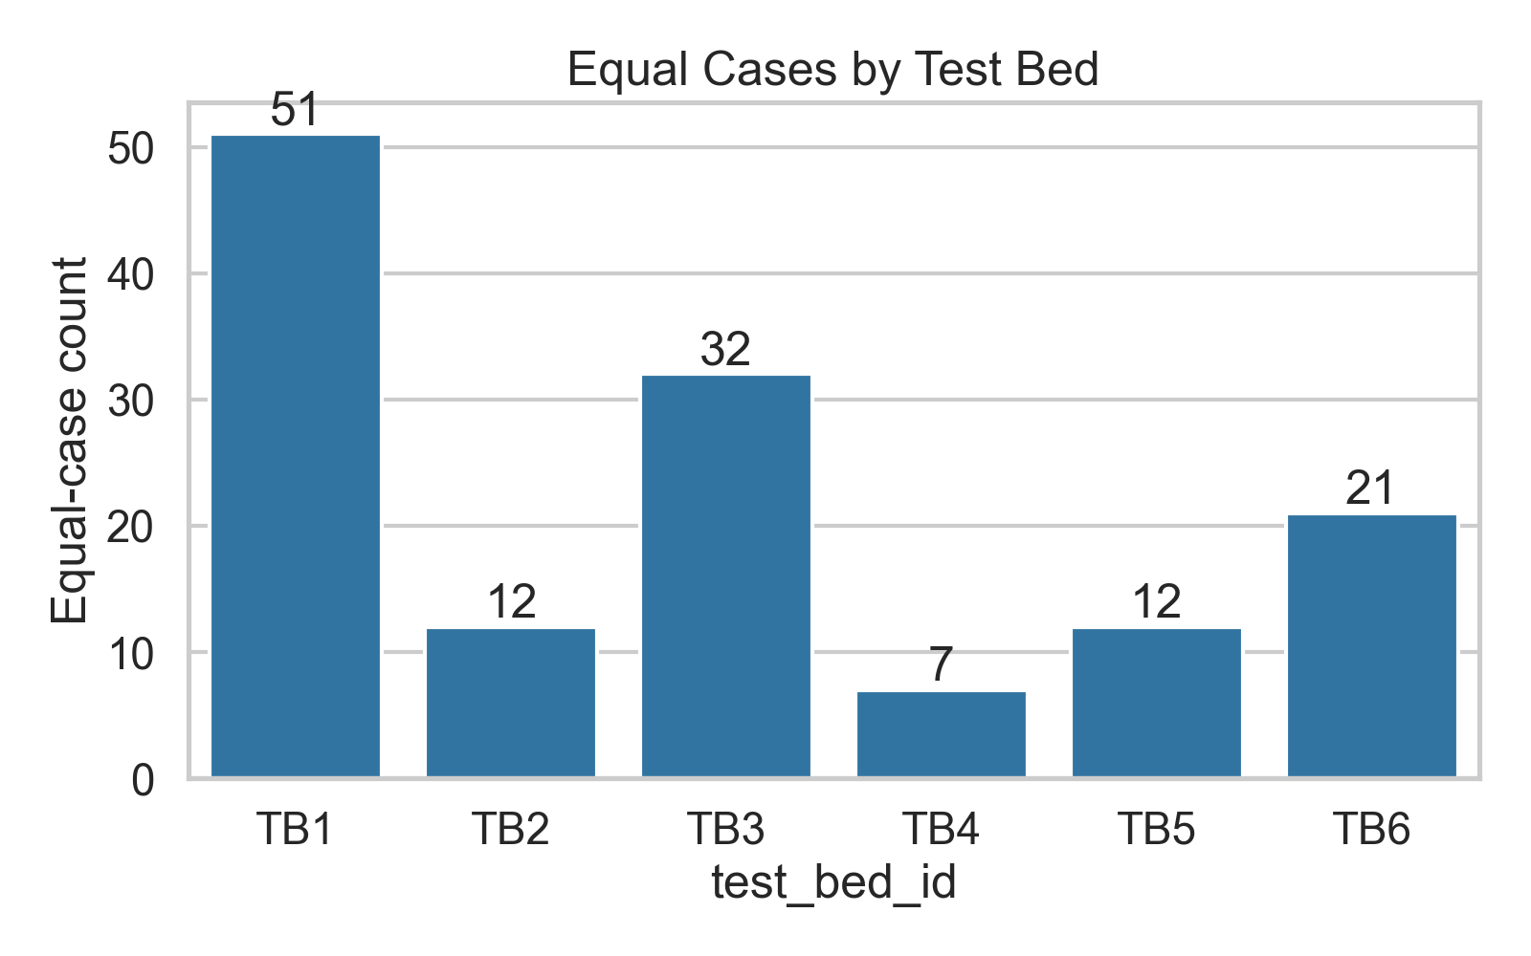
Equal Cases by Testbed
Large variation. TB1 has many equal cases, TB4 has very few.
Route characteristics (time windows, leg distances, slack) determine whether partial charging matters. Some networks are inherently easy.

Slide 25
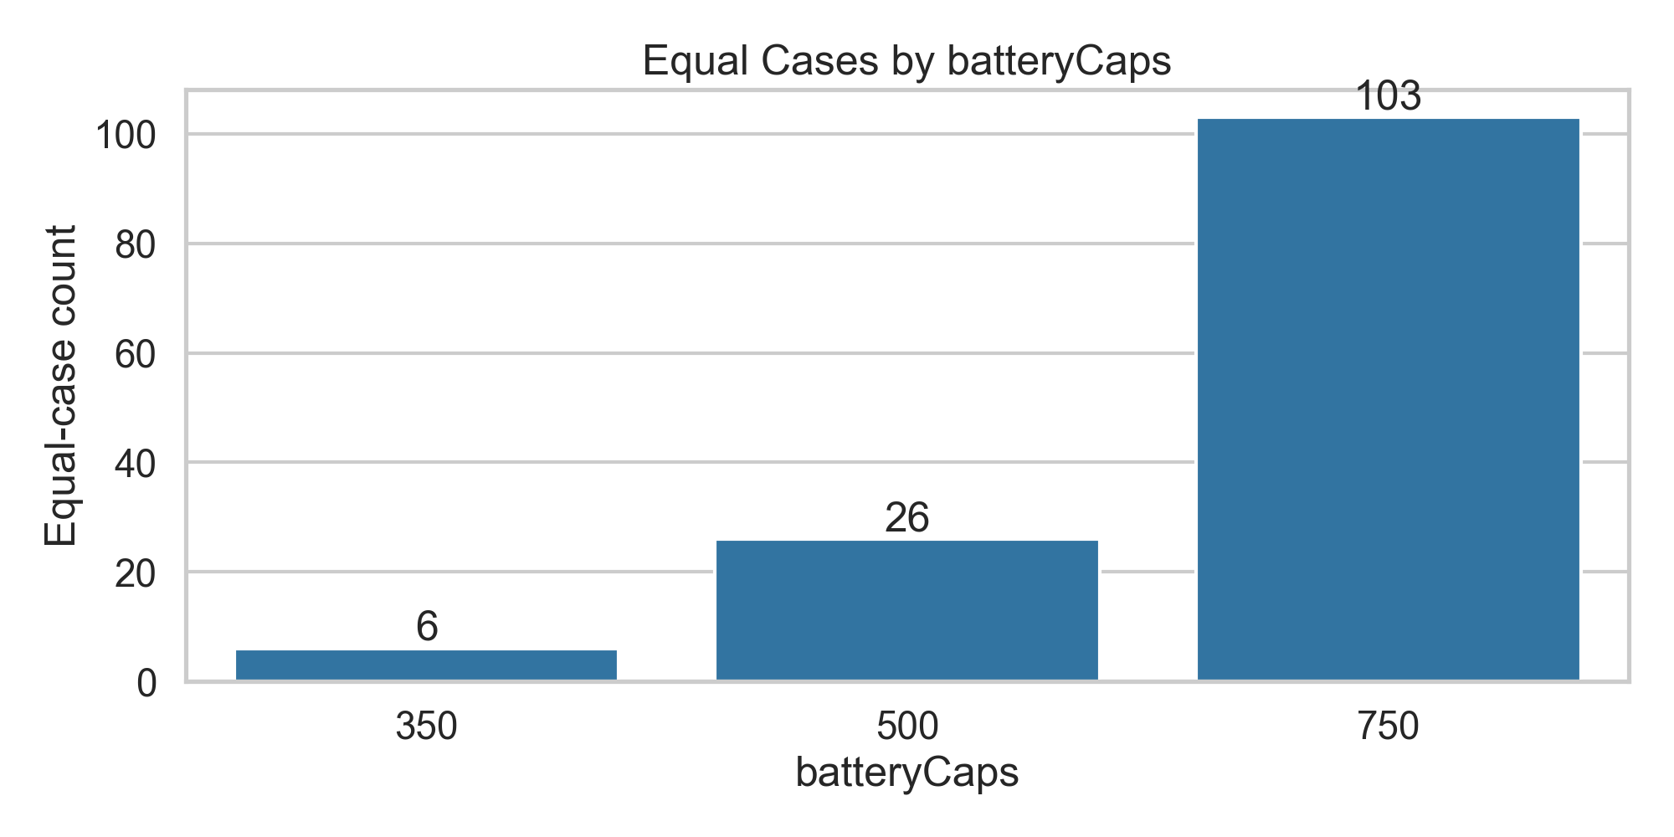
Equal Cases by Battery Caps
Almost no equal cases at 350 kWh, but many at 750 kWh.
Larger batteries reduce charging frequency, so full vs partial becomes irrelevant.

Slide 26
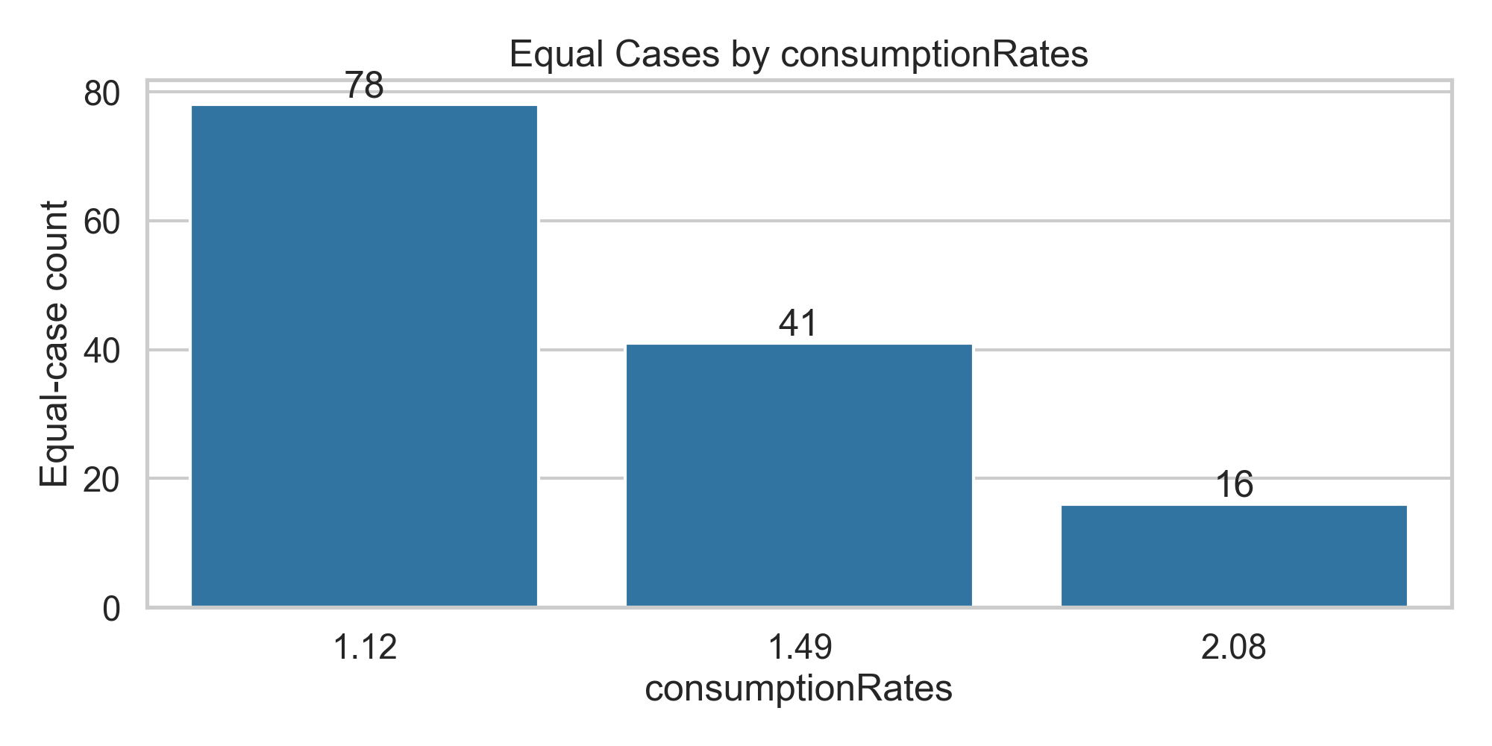
Equal Cases by Consumption Rates
Most equal cases at low consumption (1.12), very few at high consumption (2.08).
Efficient trucks need little charging, so strategies don’t differ. Inefficient trucks amplify benefits of partial charging.

Slide 27
Key Takeaways
Battery capacity: Larger batteries reduce the need for charging and variability.
Consumption rates: Inefficient trucks show the highest benefit from partial charging.
Charging power: Slow charging magnifies benefits of synchronization, fast charging reduces them.
Charging station density: Sparse networks increase the value of partial charging.
Equal cases: Most scenarios benefit from partial charging, but in unconstrained setups (big battery, fast charging, dense CS), full and partial yield the same results.

Slide 28
Meeting: 28.01.2026
Manuscript Task (paper)
Implementation Task (code)
Update methodology to include partial recharging (DONE).
Reviewing the manuscript
Writing the computational result section (waiting for the result and outline)
Preparing the test distributed to the cluster and running the test
All tests are feasible and initial results for the base scenario is ready.

Slide 29
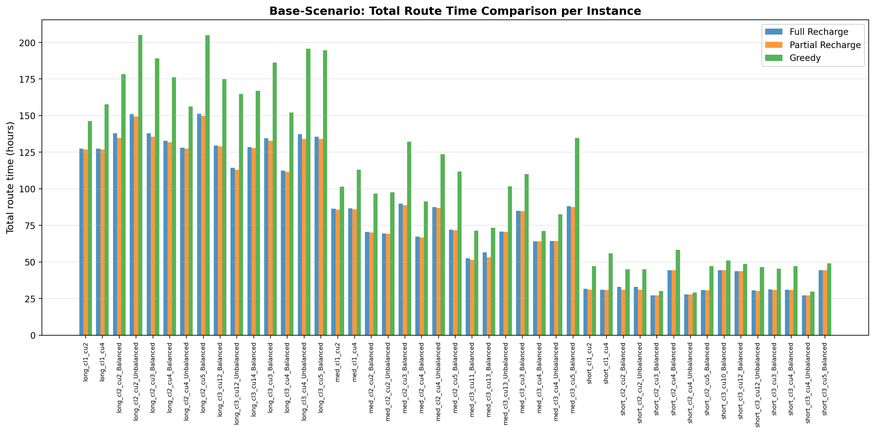
Meeting: 28.01.2026
In the base-case scenario, partial recharging improves performance by an average of 1,1% compared with the full-recharge strategy.
Energy consumption scenarios (kWh/km) = [1,49]
Inter-CS spacing (km) = [60]
Battery capacities (kWh) = [750]
Charging power (kW)= [350]

Slide 30
Meeting: 28.01.2026
In the base-case scenario, partial recharging improves performance by an average of 1,1% compared with the full-recharge strategy.
Energy consumption scenarios (kWh/km) = [1,49]
Inter-CS spacing (km) = [60]
Battery capacities (kWh) = [750]
Charging power (kW)= [350]

Slide 31
Meeting: 28.01.2026
Solution time and optimality full vs partial
Compare partial vs greedy
Comparison partial with disel (LB)
When partial strategy can be helpfull in case of different class (problem size, balanced or unbalanced)
Appendix may be can have full table with 45 rows and cloumns like route time, computational time, labels generated and dominated for each strategy in main columns

